Slide 1
Dating Analysis

Slide 2
Participants were asked to rate their date on six attributes
Attractiveness
Sincerity
Intelligence
Fun
Ambition
Shared Interests

Slide 3

data gathered from participants
demographics
dating habits
self-perception across key attributes
beliefs on what others find valuable in a partner
lifestyle information

Slide 4
Can we predict the chances of a second date?

Slide 5
participants

Slide 6
The age difference between 2-3 years had a better chance of matching

Slide 7
Heat Map

Slide 8
Heat Map

Slide 9


Slide 12
Data Cleaning

Slide 13
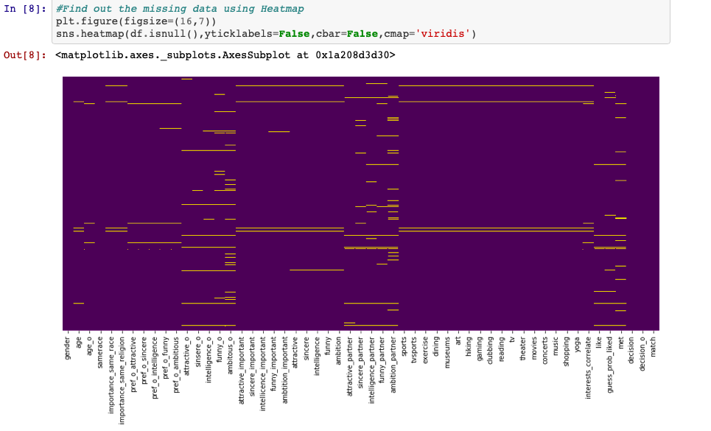
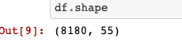

Slide 14
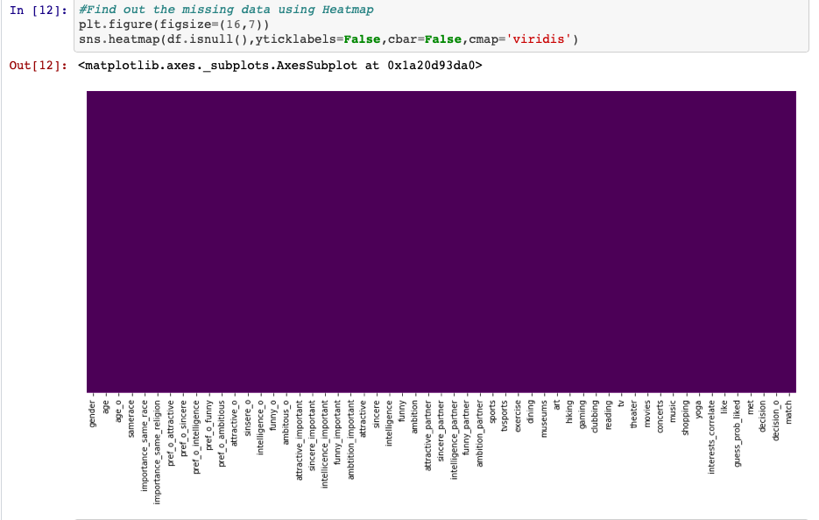
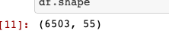

Slide 15
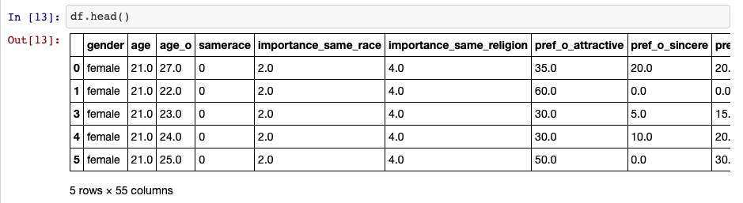

Slide 16
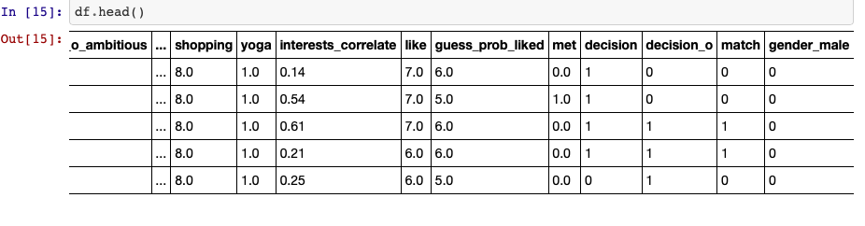

Slide 17
Machine learning model
Machine Learning Model
Decision Trees
Random Forests
Logistic Regression
K-Nearest-Neighbors
K-Nearest-Neighbors with elbow method
Deep learning with Tensorflow

Slide 18
https://github.com/Hessari/Project3/blob/master/Project3_SpeedDating_v3.ipynb

